Slide 1
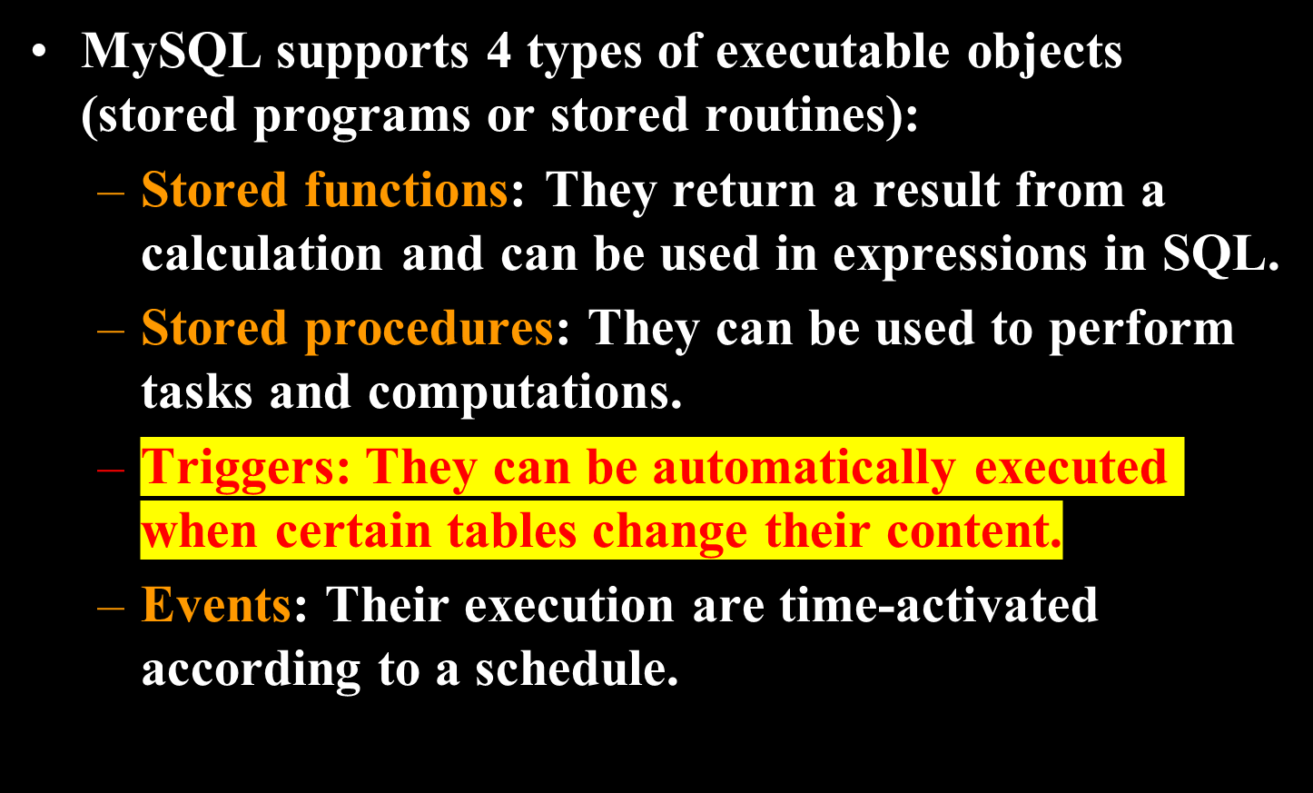
MySQL Executable Objects (1)
Select var 用于输出变量

Slide 2
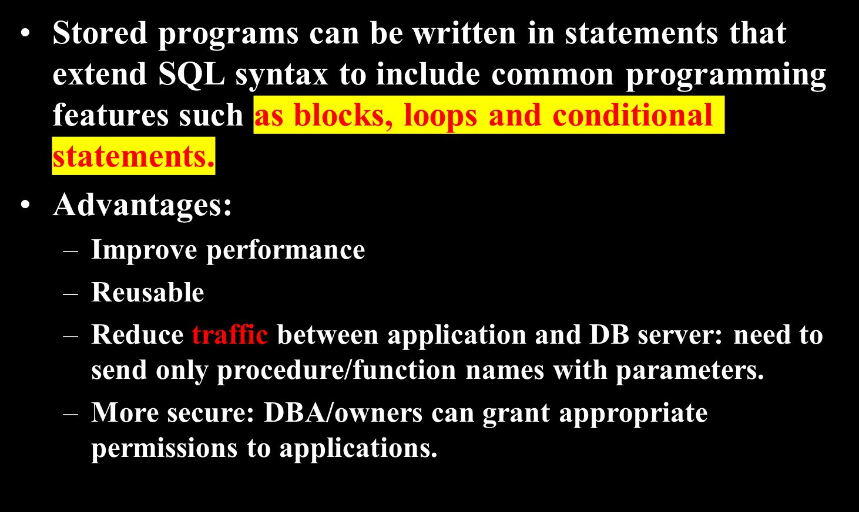
MySQL Executable Objects (2)

Slide 3
A Simple MySQL Stored Procedure
Get all employee details.
mysql > delimiter // -- replace default statement delimiter ; by //
mysql > create procedure GetAllEmployees()
begin
select * from employees;
end //
mysql > delimiter ; -- make ; the statement delimiter again
Calling Stored Procedure :
mysql > call GetAllEmployees();

Slide 4
Variables
Stored programs can have their variables.
Syntax of variable declaration:
declare variable_name datatype [default default_value];
  Datatype can be any type supported by MySQL.
Examples: declare total_sale int default 0;
declare x, y int;
Assign values to variables:
Examples: declare total_count int;
  set total_count = 10;
declare total_counts int;
select count(*) into total_counts from employees;

Slide 5
Variable Scope
If you declare a variable inside a stored procedure, it will be out of scope when the end statement of stored procedure is reached.
If you declare a variable inside a begin-end block, it will be out of scope if the end is reached.
A variable that begins with the @ sign at the beginning is a session variable. It is available and accessible until the end of the session.

Slide 6
@variable
MySQL has the concept of session variables. They are loosely typed variables that may be initialized somewhere in a session and keep their value until the session ends.
They are with an @ sign, like this: @var
You can initialize @ variables like
  mysql> set @x = 1;
  mysql> select @x;

Slide 7
Another Example (1)
mysql> delimiter //
mysql> create procedure prc_test ( )
begin
declare var2 int default 1;
set var2 := var2 + 1;
set @var2 := @var2 + 1;
select var2, @var2;
end //
mysql> delimiter ;

Slide 8
Another Example (2)
mysql > set @var2 = 1;
mysql > call prc_test();
  output:
  var2 @var2
  ----- --------
  2 2
mysql > call prc_test();
  var2 @var2
  ----- --------
  2 3
mysql > call prc_test();
  var2 @var2
  ----- --------
  2 4
@ variables can carry their values across different procedure calls.

Slide 9
Basic Syntax of Stored Procedures/Functions
Procedures
create procedure proc_name ([parameters])
routine_body
Functions
create function func_name ([parameters])
returns data_type routine_body
Parameter definition:
[ in | out | inout ] param_name data_type
  “in” is the default
  Only in parameter can be used for function

Slide 10
Parameter Modes
IN: Default mode.
  The calling program must pass an argument to each in parameter.
OUT
  The value of an out parameter can be changed inside the stored procedure and its new value is passed back to the calling program.
INOUT
  Combination of in & out

Slide 11
Example 3
Create a procedure to return the number of students in any given department.
mysql> delimiter //
mysql> create procedure GetStudentSizeByDept(in deptname varchar(50))
begin
select count(*) from Students
where dept_name = deptname;
end //
mysql> delimiter ;
mysql> call GetStudentSizeByDept(‘CS’);

Slide 12
Example 3: Another Way
Another way to write the procedure in the previous slide.
mysql> delimiter //
mysql> create procedure GetStudentSizeByDept1(in deptname varchar(50), out num_of_students int)
begin
select count(*) into num_of_students
from Students
where dept_name = deptname;
end //
mysql> delimiter ;
mysql> call GetStudentSizeByDept1(‘CS’, @num_of_students);
mysql> select @num_of_students;

Slide 13
Example 4
Create a function to return the number of students in any given department.
mysql> delimiter //
mysql> create function GetStudentSizeByDept2(in deptname varchar(50)) returns int
begin
declare num_of_students int;
select count(*) into num_of_students from Students
where dept_name = deptname;
return (num_of_students);
end //
mysql> delimiter ;
mysql> select GetStudentSizeByDept2(‘CS’);

Slide 14
Example 4: Another Way
Here is another way to write the function in the previous slide.
mysql> delimiter //
mysql> create function GetStudentSizeByDept2(in deptname varchar(50)) returns int
begin
return (select count(*) from Students
where dept_name = deptname);
end //
mysql> delimiter ;

Slide 15
Example 5
mysql> delimiter //
mysql> create procedure set_counter(inout count int(4),
in increment int(4))
begin
set count = count + increment;
end //
mysql> delimiter ;
mysql> set @counter = 1;
mysql> call set_counter(@counter, 1); -- 2
mysql> call set_counter(@counter, 1); -- 3
mysql> call set_counter(@counter, 5); -- 8
mysql> select @counter; -- 8

Slide 16
IF Statement
Syntax:
IF if_expression THEN commands
[ELSEIF elseif_expression THEN commands]
[ELSE commands]
END IF;

Slide 17
Example 6
mysql> delimiter //
mysql> create procedure GetCustomerLevel(
in p_customerNumber int(11),
out p_customerLevel varchar(10))
begin
declare creditlim double;
select creditlimit into creditlim from customers
where customerNumber = p_customerNumber;
if creditlim > 50000 then
set p_customerLevel = 'PLATINUM';
elseif (creditlim <= 50000 and creditlim >= 10000) then
set p_customerLevel = 'GOLD';
elseif creditlim < 10000 then
set p_customerLevel = 'SILVER';
end if;
end//
mysql> delimiter ;

Slide 18
Case Statement
Switch-case
Syntax:
CASE case_expression
WHEN when_expression_1 THEN commands
WHEN when_expression_2 THEN
commands
...
ELSE commands
END CASE;

Slide 19
Example 7
mysql> delimiter //
mysql> create procedure GetCustomerShipping(
in p_customerNumber int(11),
out p_shiping varchar(50))
begin
declare customerCountry varchar(50);
select country into customerCountry from customers
where customerNumber = p_customerNumber;
CASE customerCountry
WHEN 'USA' THEN
set p_shiping = '2-day Shipping';
WHEN 'Canada' THEN
set p_shiping = '3-day Shipping';
ELSE
set p_shiping = '5-day Shipping';
END CASE;
end //
mysql> delimiter ;

Slide 20
Loop Statements
While Loop
WHILE expression DO
Statements
END WHILE;
Repeat Loop
REPEAT
Statements;
UNTIL expression
END REPEAT;

Slide 21
Example 8
mysql> delimiter //
mysql> drop procedure if exists WhileLoopProc //
mysql> create procedure WhileLoopProc()
begin
declare x int; declare str varchar(255);
set x = 1; set str = '';
WHILE x <= 5 DO
set str = concat(str, x, ','); set x = x + 1;
END WHILE;
select str;
end //
mysql> delimiter ;
mysql> call WhileLoopProc();
Output :
str
----
1,2,3,4,5,

Slide 22
Example 8 (Continued)
We can replace the WHILE loop in the example in the previous slide by the following REPEAT loop
REPEAT
set str = concat(str, x, ',');
set x = x + 1;
UNTIL x > 5 -- no semicolon here
END REPEAT;

Slide 23
Loop, Leave & Iterate
LEAVE : Equivalent to break in JAVA, C/C++, PHP
ITERATE : Equivalent to continue
They can be used to create another loop mechanism.

Slide 24
Example 9
mysql> delimiter //
mysql> create procedure LOOPLoopProc()
mysql> begin
declare x int; declare str VARCHAR(255);
set x = 1; set str = '';
loop_label: LOOP
IF x > 10 THEN
LEAVE loop_label;
END IF;
set x = x + 1;
IF (x mod 2) THEN
ITERATE loop_label;
ELSE
set str = concat(str, x, ',');
END IF;
END LOOP;
select str;
end //
mysql> delimiter ;
Output :
str
----
2,4,6,8,10,

Slide 25
MySQL Cursor (1)
Consider an SQL query returning multiple rows.
Question: How to save the result of the query?
One possibility: Save the result into a big array.
  No easy way to estimate the size of the result.
  The result could be too large for any memory-based array.
Save one-row-at-a-time: This is the SQL approach.
  Cursor is a mechanism for implementing this approach.

Slide 26
MySQL Cursor (2)
Cursor is used to iterate through a result set returned by a select statement one row at a time.
MySQL Cursors are:
  Read Only : Can not update data in the underlying table through cursor.
  Non-Scrollable : Can only go through rows in the result set in forward order. You can not travel backward or skip rows.

Slide 27
MySQL Cursor (3)
Syntax for defining a cursor:
declare cursor_name cursor for select_statement;
Example:
declare c1 cursor for
  select cid, cname, city from customers;
The query defining the cursor is not executed at the declaration time.
Cursor declaration comes after variable declaration.
Question: What’s the difference between cursor and a view?

Slide 28
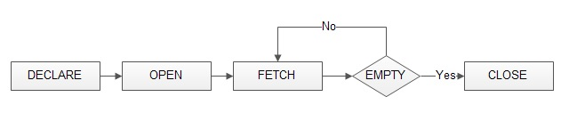
MySQL Cursor (4)
Statements for working with cursors:
  open cursor_name;
  fetch cursor_name
  into record_or_variable_list;
  close cursor_name;
Open causes the query defining the cursor to be executed.
定义时没有运行

Slide 29
MySQL Cursor (5)
A cursor always points to the prior row. Each fetch statement will first advance the cursor position by 1 and then retrieve the values in the pointed row.
A cursor can be re-opened after it is closed. Re-opened cursor points to the beginning of the table.
A cursor is not needed if you are sure that the result can have at most one row.
  In this case, you can use “select … into …”

Slide 30
MySQL Cursor (6)
When working with MYSQL cursor, also need to declare a NOT FOUND Handler to handle the situation when the cursor could not find any row when the next FETCH statement is executed.
Declare a NOT FOUND Handler
  declare continue handler for not found set finished = 1;

Slide 31
Example 10
mysql> delimiter //
mysql> create procedure build_email_list (inout email_list varchar(4000))
begin
declare v_finished int default 0;
declare v_email varchar(100) default '';
-- declare cursor for employee email
declare email_cursor cursor for select email from employees;
-- declare NOT FOUND handler
declare continue handler for not found set v_finished = 1;
open email_cursor;
get_email: loop
fetch email_cursor into v_email;
if v_finished = 1 then
leave get_email; -- exit the loop
end if;
-- build email list with “;” as the delimiter
set email_list = concat(v_email, ';', email_list);
end loop get_email;
close email_cursor;
end //
注释

Slide 32
Example 10 (Continued)
mysql> delimiter ;
Test:
mysql> set @email_list = '';
mysql> call build_email_list(@email_list);
mysql> select @email_list;
Output :
@email_list
-----------------
a@gmail.com;b@gmail.com;c@gmail.com; (List of all email id separated by ;)

Slide 33
Stored Procedure/Function Information (1)
To find information about a stored procedure or function, use the following statement:
Syntax:
  show procedure | function status [where expression];
Examples:
mysql> show procedure status;
mysql> show function status where name like '%product%‘;

Slide 34
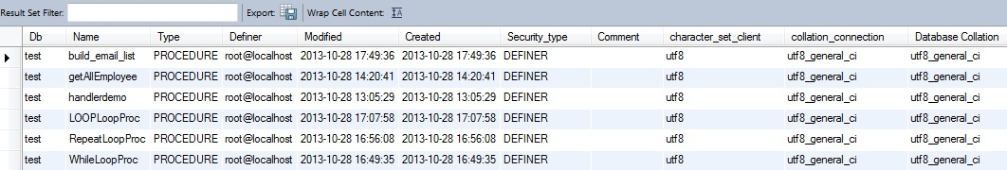
Sample Output of
“show procedure status” in Workbench

Slide 35
Stored Procedure/Function Information (2)
To see a stored procedure’s or function’s source code, use
show create procedure | function stored_procedure_name;
Examples:
mysql> show create procedure build_email_list;
mysql> show create function GetStudentSizeByDept2;

Slide 36
Trigger (1)
A trigger is an event-driven block of MySQL.
An event could be an insertion of a tuple into a table, a deletion of an existing tuple from a table, and an update of a table.
A trigger fires (executes, activates) when an event occurs.
Triggers are useful for enforcing various integrity constraints and business rules.

Slide 37
Trigger (2)
ECA Model:
Event Condition Action
MySQL currently only supports the event-action part.
an event
detected?
yes
Is the event
significant?
yes
take
actions
insert
delete
update
need to satisfy
additional
condition
execute
MySQL
block

Slide 38
Trigger (3)
Syntax for creating trigger:
create trigger trigger_name
{ before | after }
{ insert | update | delete }
on table_name
for each row
<trigger body>
Syntax for deleting trigger:
drop trigger [if exists] trigger_name

Slide 39
Trigger (4)
Trigger event examples
  update on employees
  insert on employees
  delete on employees
trigger timing
  before: execute the trigger body before executing the triggering statement
  after: execute the trigger body after executing the triggering statement

Slide 40
Trigger (5)
row trigger
  “for each row” is specified
  Execute the trigger body once for each row that is affected by the event
statement trigger
  “for each row” is not specified
  fire the trigger once for the entire trigger event
  Statement trigger is not supported by MySQL.

Slide 41
Trigger (6)
Within the trigger body, the OLD and NEW keywords enable you to access columns in the rows affected by a trigger.
  In an INSERT trigger, only NEW.col_name can be used; there is no old row.
  In a DELETE trigger, only OLD.col_name can be used; there is no new row.
  In an UPDATE trigger, you can use OLD.col_name to refer to the columns of a row before it is updated and NEW.col_name to refer to the columns of the row after it is updated.

Slide 42
Trigger (7)
A column named with OLD is read only.
In a BEFORE trigger, you can also change its value with “set NEW.col_name = value”.
  This makes it possible to use a trigger to modify the values to be inserted into a new row or used to update a row.
  Such a set statement has no effect in an AFTER trigger because the row change has already occurred.

Slide 43
Trigger Example 1
We want to insert tuples into table Sale(Percent, Sale_Date), where Percent must be between 5 and 80. Any attempt to insert a Percent below 5 will be replaced by 5 and that above 80 by 80. The Sale_Date value will be the current date.
mysql> create trigger before_insert_sale
before insert on Sale for each row
begin
set new.sale_date = curdate();
if new.percent < 5 then
set new.percent = 5;
elseif new.percent > 80 then
set new.percent = 80;
end if;
end //

Slide 44
Trigger Example 2
Use trigger for monitoring changes
Example: Add a log entry each time the price of a product is changed.
log table for product:
create table product_log
(pid varchar(4),
username varchar(20),
update_time datetime,
old_price decimal(6, 2),
new_price decimal(6, 2));

Slide 45
Sample Example 2 (Continued)
mysql> create trigger update_product_price
after update on products
for each row
begin
if old.price <> new.price then
insert into product_log values
(old.pid, user(), current_timestamp,
old.price, new.price);
end //

Slide 46
Trigger Example 3
Use trigger to enforce integrity constraints
Example: If a student is removed, delete all enrollments by the student.
mysql> create trigger stud_enroll
after delete on students
for each row
begin
delete from enrollments where sid = old.sid;
end //
If there is just one statement in the trigger body, “begin … end” is optional.

Slide 47
Trigger Example 4
Use trigger to maintain data consistency
Example: If an order is made for a product with certain quantity, then the quantity on hand of the product should be reduced accordingly.
mysql> create trigger prod_qoh_on_order
after insert on orders for each row
begin
update products
set quantity = quantity – new.qty
where pid = new.pid;
end //

Slide 48
Trigger Restrictions
Triggers can not:
  Modify a table being used by the DML without NEW or OLD aliases.
  Use SELECT without INTO variable_name.
  Use SHOW commands.
  Use ALTER VIEW.
  Use RETURN in stored programs.
  Use statements that explicitly or implicitly begin or end a transaction, such as “start transaction”, “commit”, or ”rollback”.

Slide 49
Handling Trigger Errors in MySQL
If a BEFORE trigger fails, the operation on the corresponding row is not performed.
A BEFORE trigger is activated by the attempt to insert or modify the row, regardless of whether the attempt subsequently succeeds.
An AFTER trigger is executed only if any BEFORE triggers and the row operation execute successfully.
An error during either a BEFORE or AFTER trigger results in failure of the entire statement that caused trigger invocation.
For transactional tables, failure of a statement causes rollback of all changes performed by the statement.
For non-transactional tables, rollback cannot be done, any changes performed prior to the error point remain in effect.

Slide 50
Events
In MySQL, an event is a stored program that executes according to a schedule.
Basic create event syntax:
create event event_name
on schedule schedule_spec
do event_body;
  schedule_spec: at timestamp [+ interval interval_spec] | every interval [starts timestamp [+ interval interval_spec] ] [ends timestamp [+ interval interval_spec] ]
  interval_spec: quantity {year | quarter | month | day | hour | minute | week | second | year_month | day_hour | day_minute | day_second | hour_minute | hour_second | minute_second}

Slide 51
Event Example 1
Suppose we have table MySchedule(event_name, event_time, event_place).
Create an event that will add a tuple about a meeting into MySchedule 3 hours from now:
mysql> create event my_schedule
on schedule at current_timestamp
+ interval 3 hours
do insert into MySchedule values (‘faculty
meeting’, ‘2013-11-14 16:30:00’, ‘G11’);

Slide 52
Event Example 2
Create an event that removes activity tuples that have expired from MySchedule every day:
mysql> create event my_schedule
on schedule every 1 day
do delete from MySchedule
where event_time < current_timestamp;
  The event runs immediately after its creation and then once each day.

